Slide 1
Online hospital MANAGEMENT SYSTEM for
Healthcare plus hospital.
ITE 3962 Final Year Project (24S2)
Presented by:
E2240189 - E.M.M.G.D.B. Edirisinghe.
Bachelor of Information Technology

Slide 2





Introduction
HealthCare Plus is a leading hospital.
They need a system including patient care, streamline operations, and improve communication between patients and healthcare providers.
They need a full-featured hospital management platform that streamlines clinical and administrative operations.

Slide 3

Motivation
The motivation is to replace the inefficient, error-prone manual system at HealthCare Plus Hospital with a centralized online solution that ensure accuracy, consistency and efficient management of hospital resource.

Slide 4


Problem in Brief
HealthCare Plus hospital currently uses a manual system for managing and maintaining critical information.
The system relies on numerous paper forms, with data spread across the hospital infrastructure.
Information on forms is often incomplete or not aligned with management standards.
Multiple copies of the same information exist, leading to data inconsistencies.

Slide 5

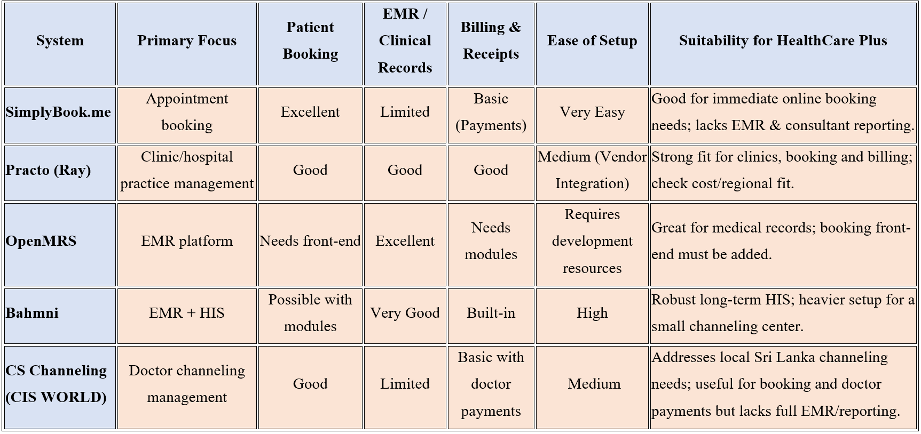
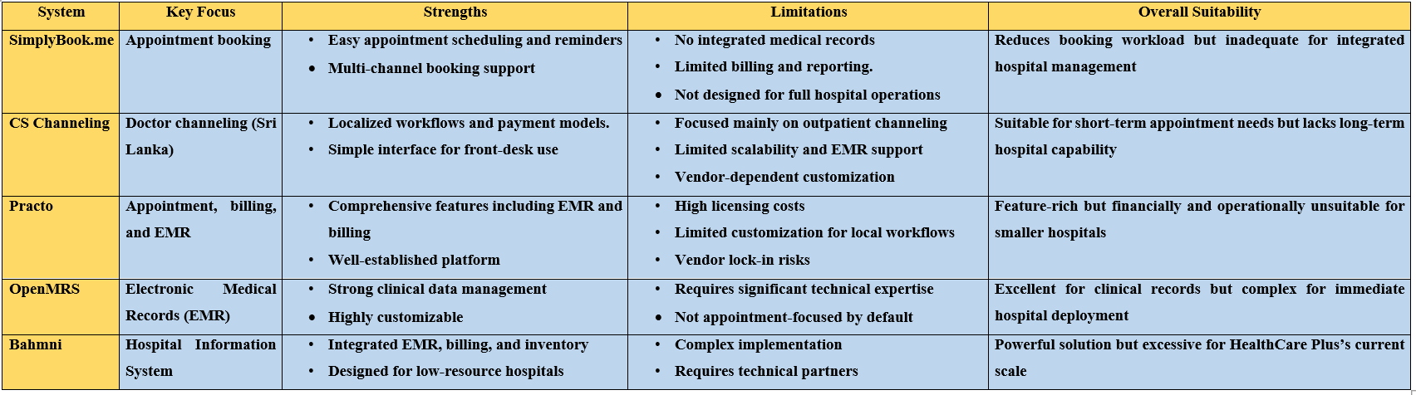
Existing System Comparison

Slide 6

Proposed Solution
The proposed solution uses modern technologies such as HTML, CSS and JavaScript as front-end technologies, PHP as back-end technologies and MySQL as database to streamline hospital operations, enhance patient care and reduce operational costs.
There is a new feature introduces in the system is AI-powered symptom checker will develop using OpenAI GPT API that allows to patients to input their symptoms and receive preliminary guidance on possible conditions before scheduling an appointment.
There also another new feature introduces in the system Email notification service.

Slide 7
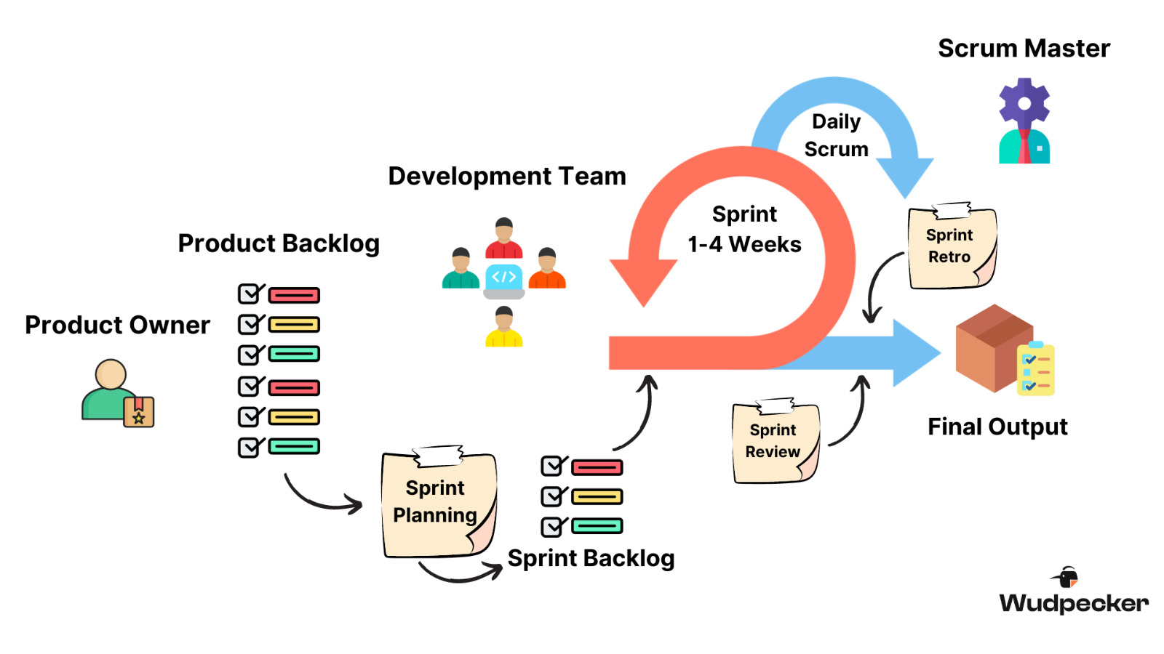
Methodology
Requirement Gathering
Sprint Planning
Development
Testing
Deployment
Review & Feedback
Continuous Improvement
The Agile Methodology used to develop the HealthCare Plus Online Hospital Management system.

Slide 8








technologies
FRONTEND TECHNOLOGIES
BACKEND TECHNOLOGIES
SERVER
DATABASE
CODE EDITOR

Slide 9

Here are the Features of the System:
Patient Management
Appointment Scheduling
Billing and Payment
Patients Medical Record Management
AI-Powered Symptom Checker
Staff and Resource Management
Feedback and Support
Doctor Scheduling and Appointment Booking
Admin Panel for System Maintenance
Hospital Monthly Report Management.

Slide 10
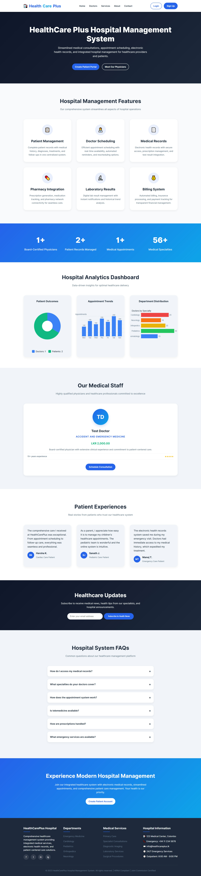
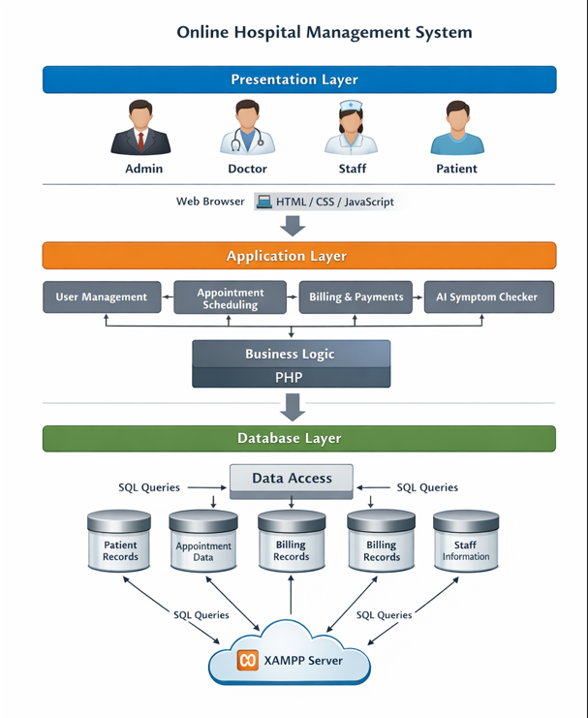
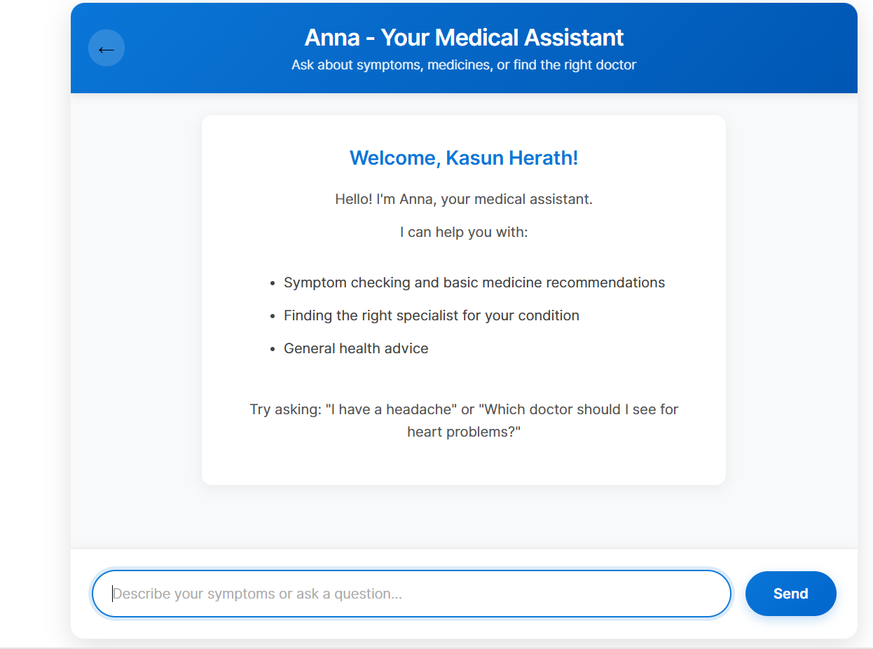
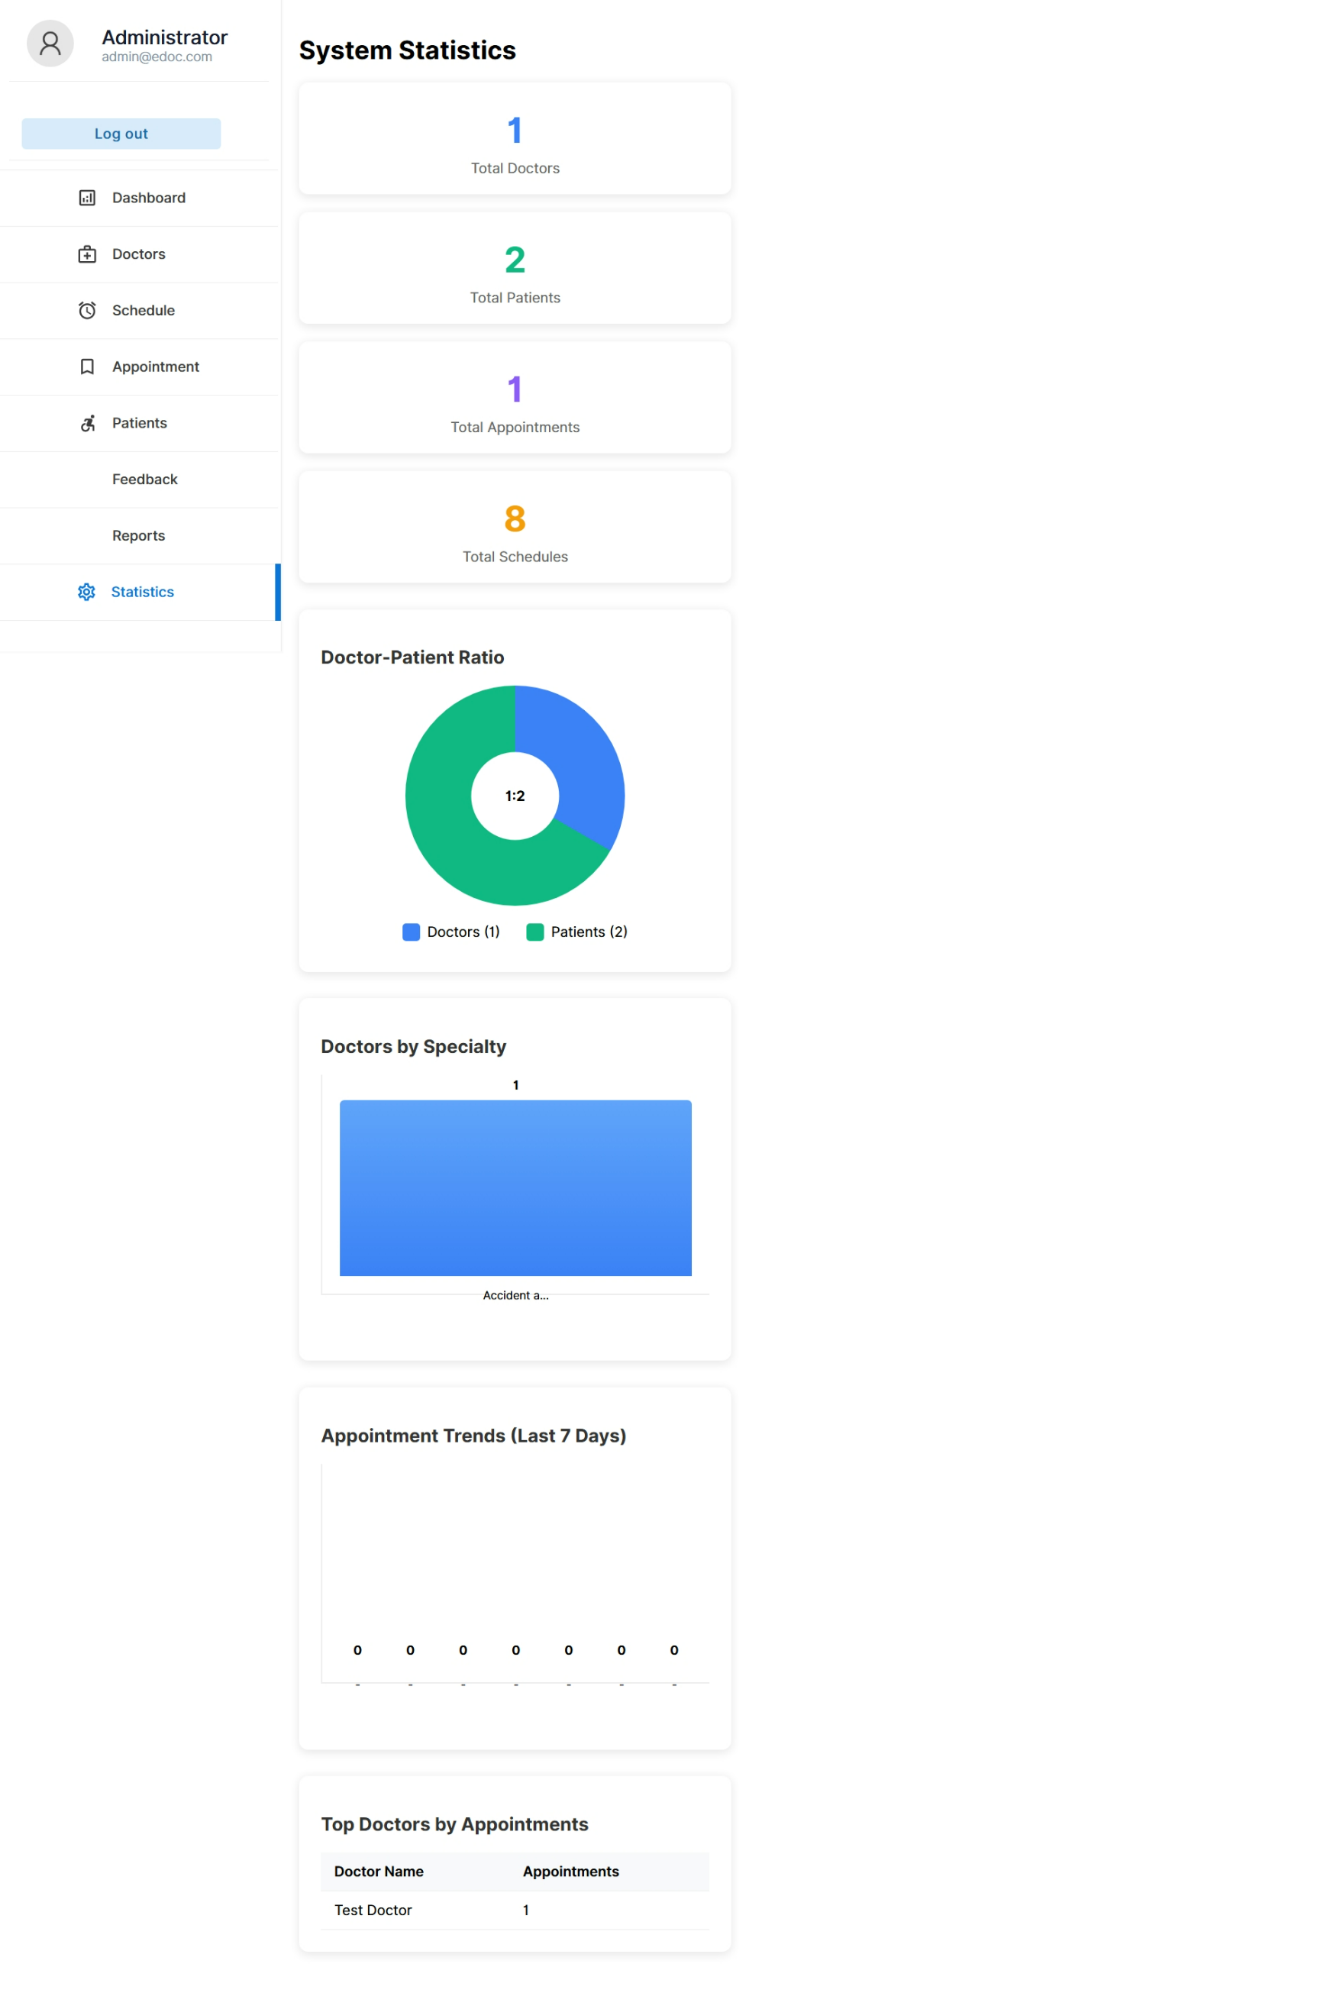
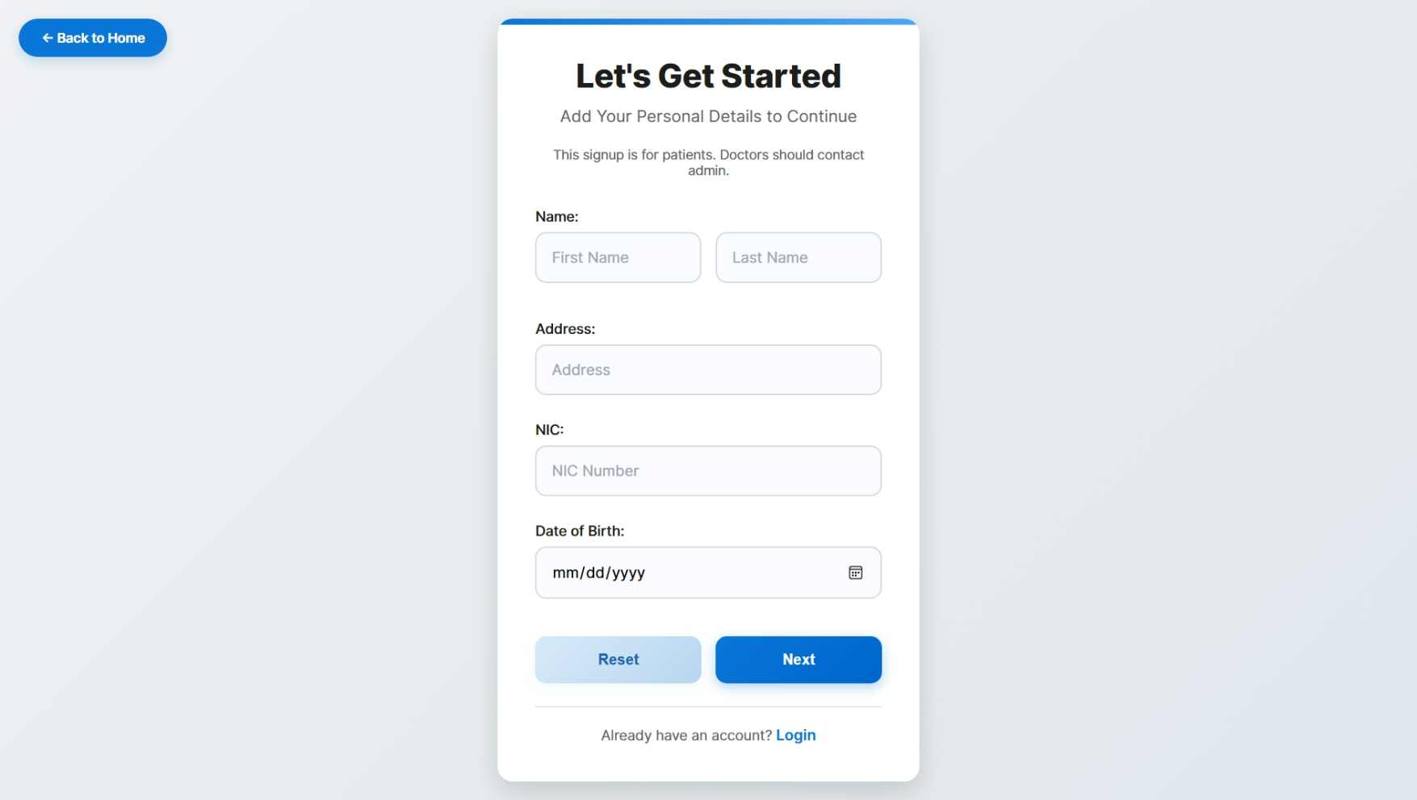
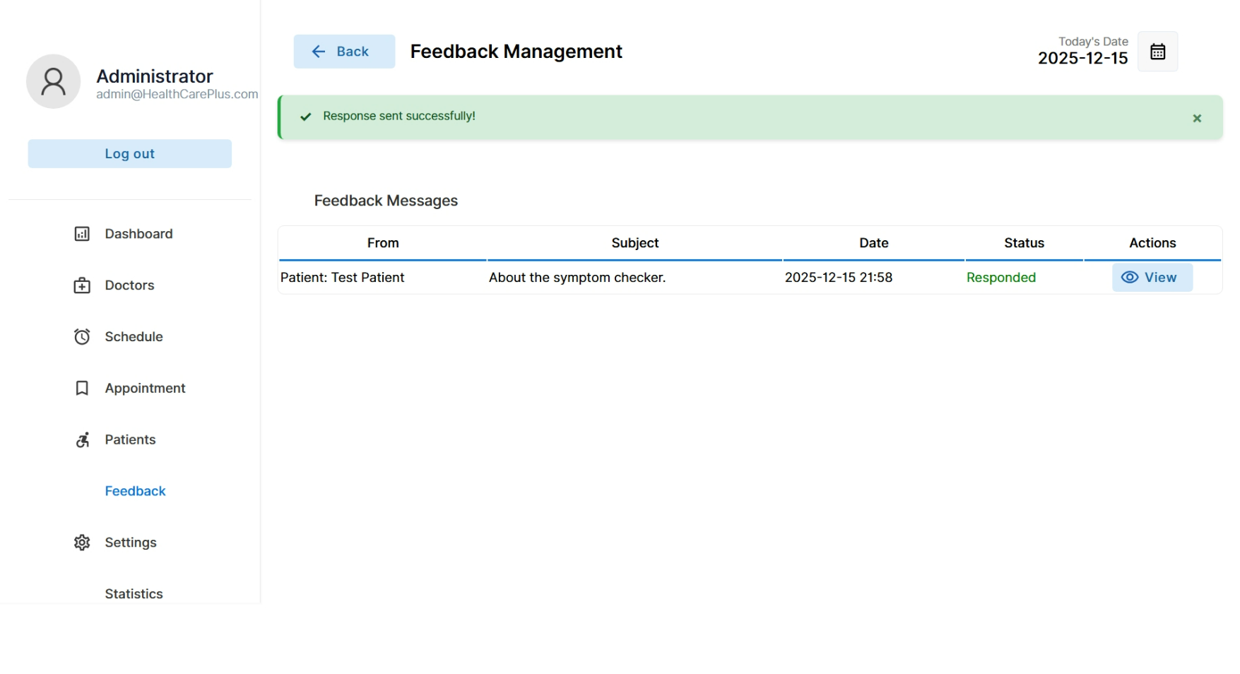
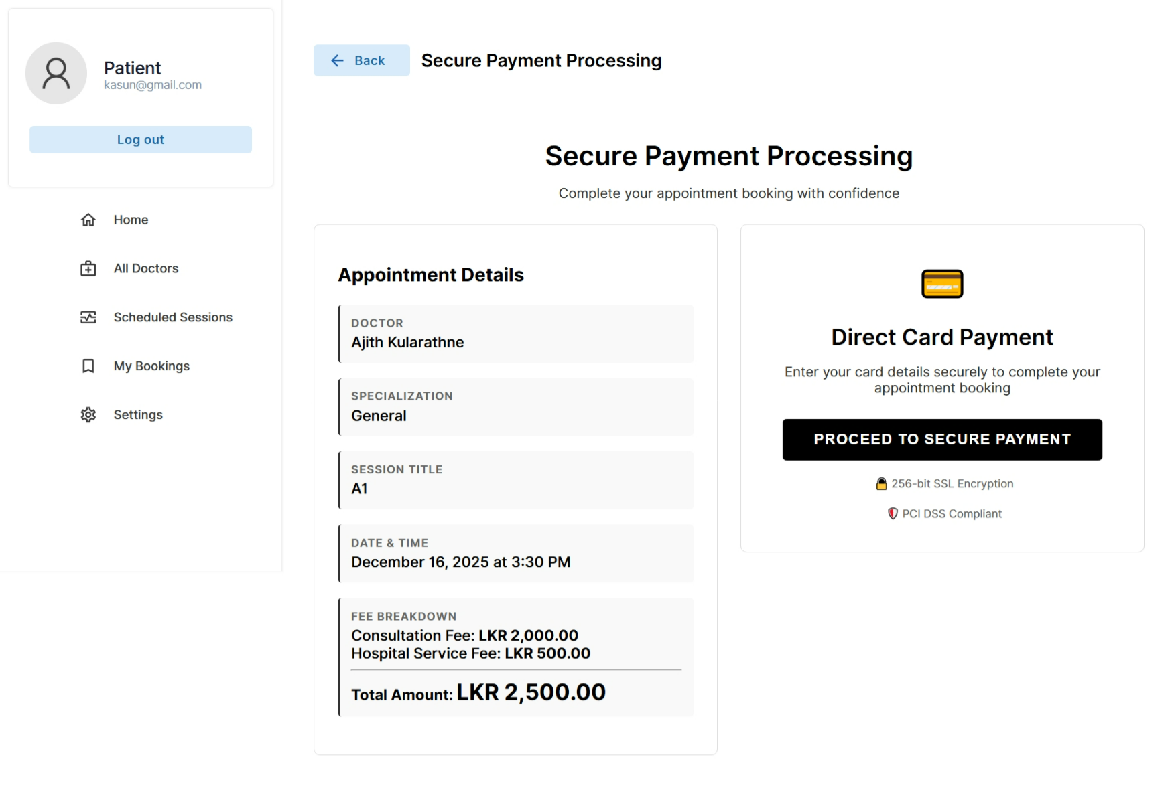
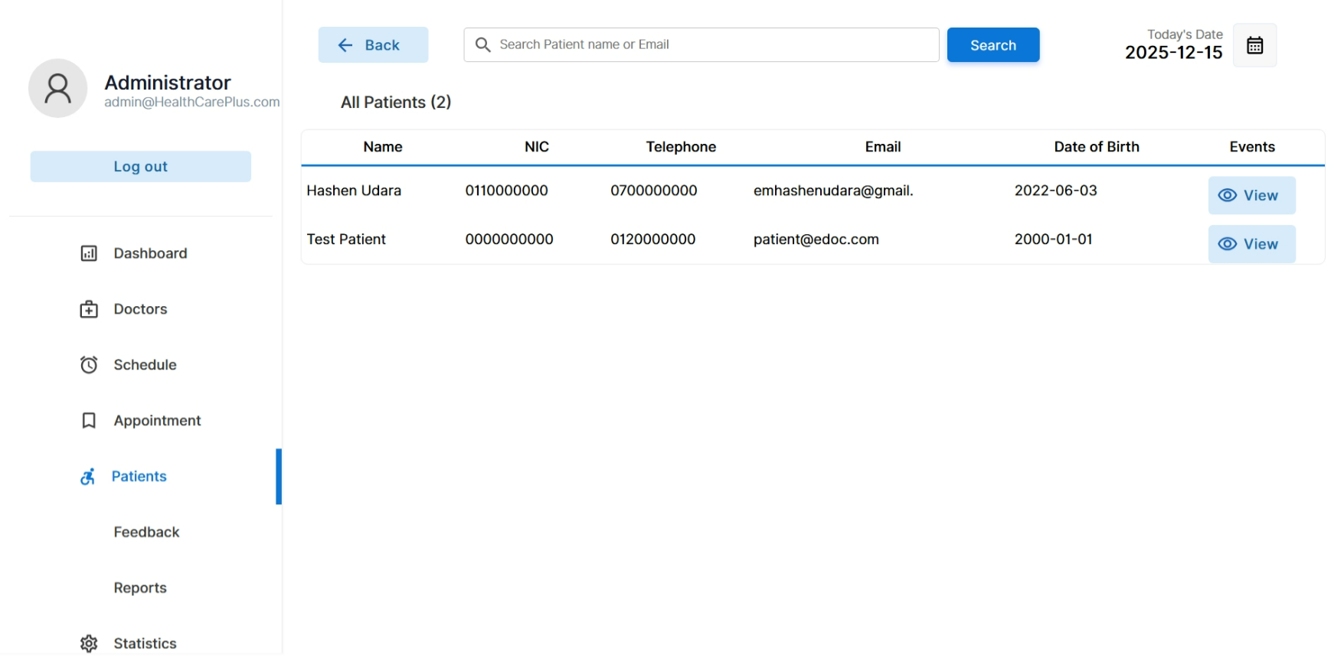
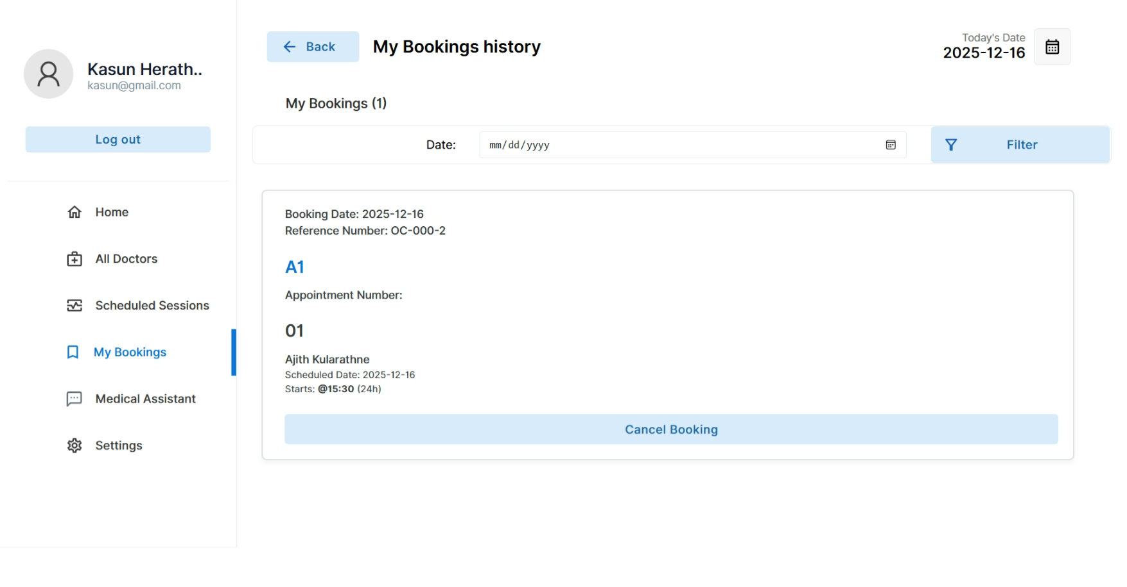
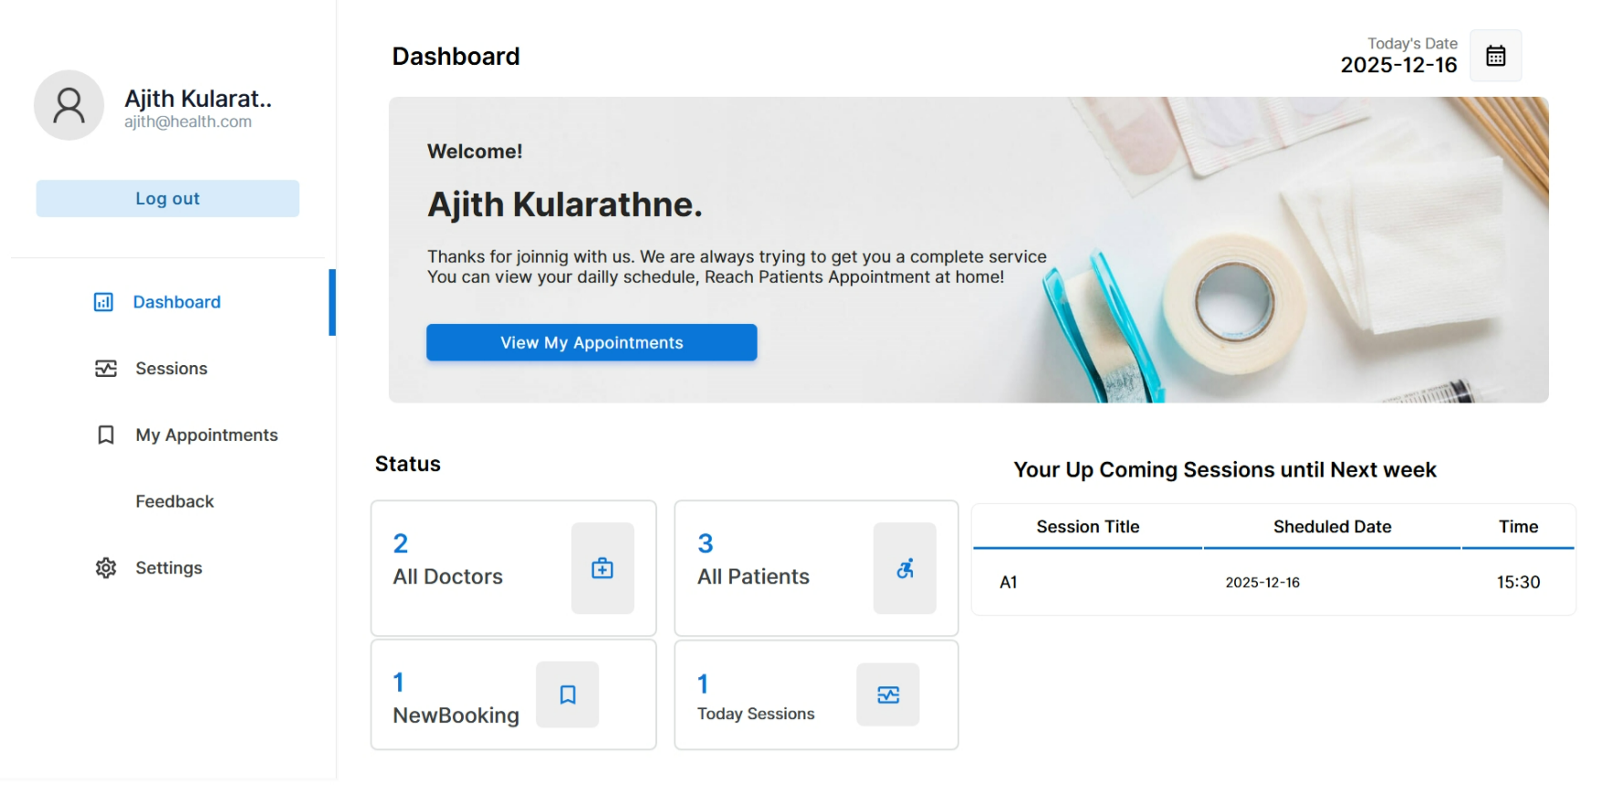
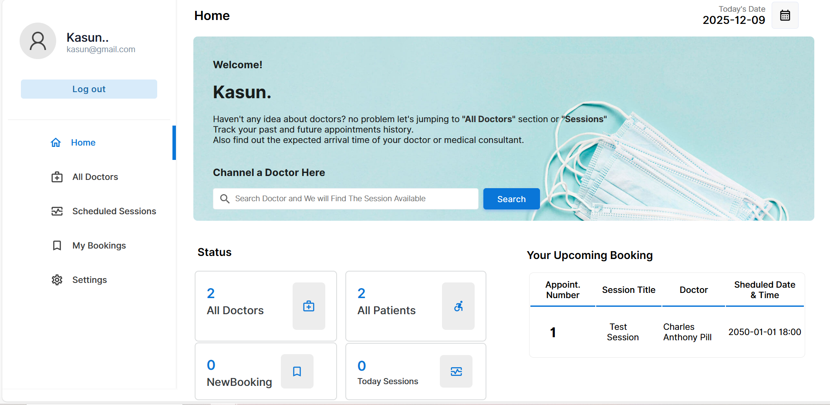
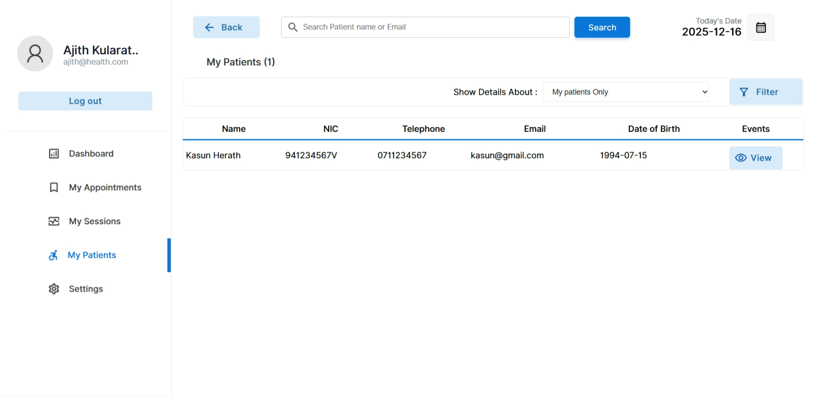
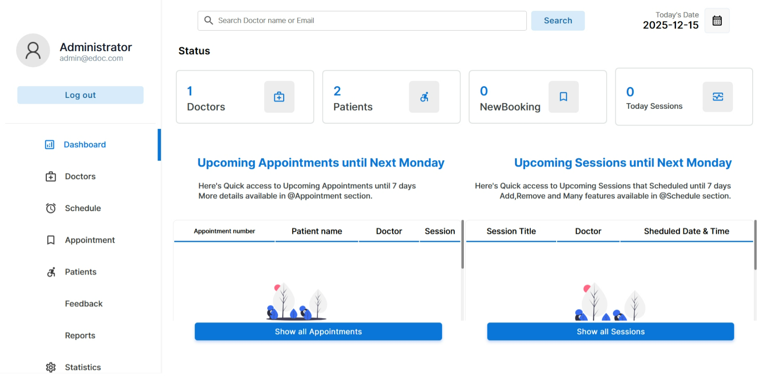
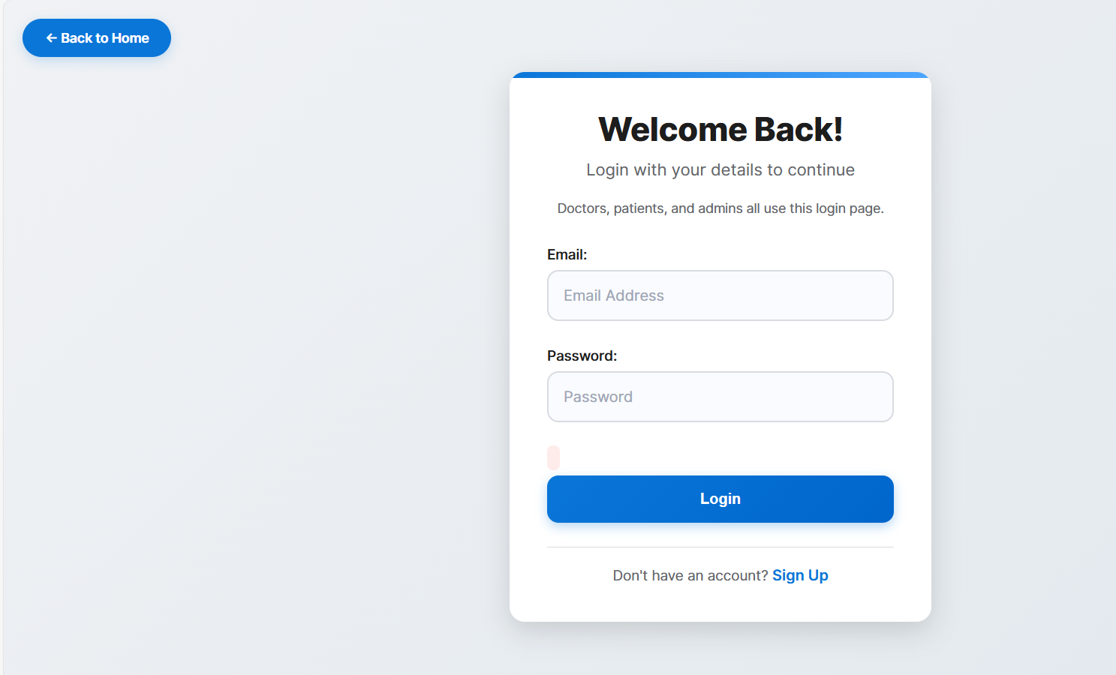
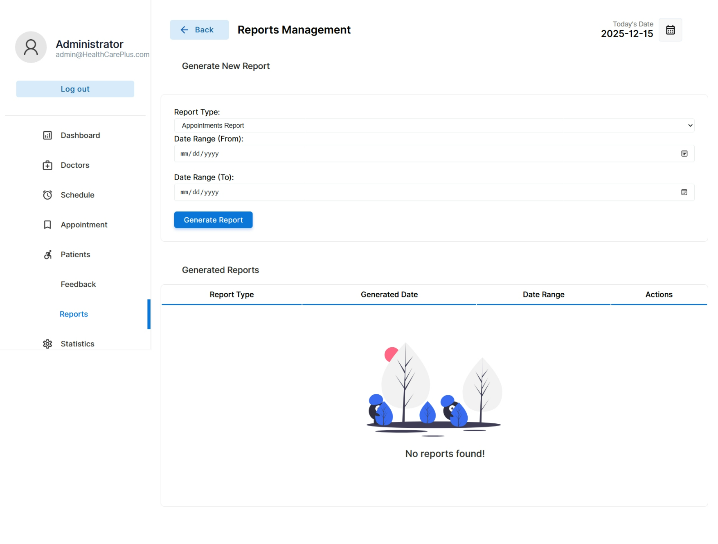
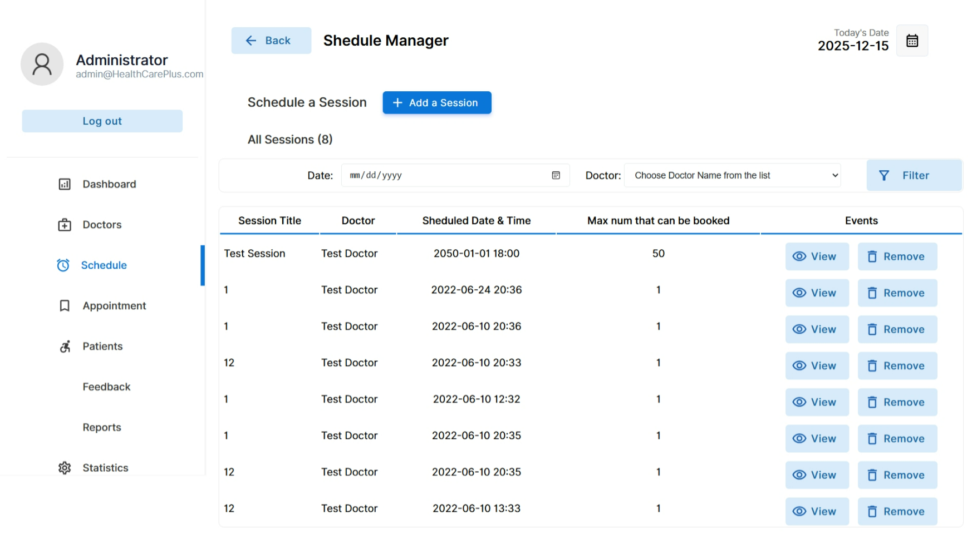
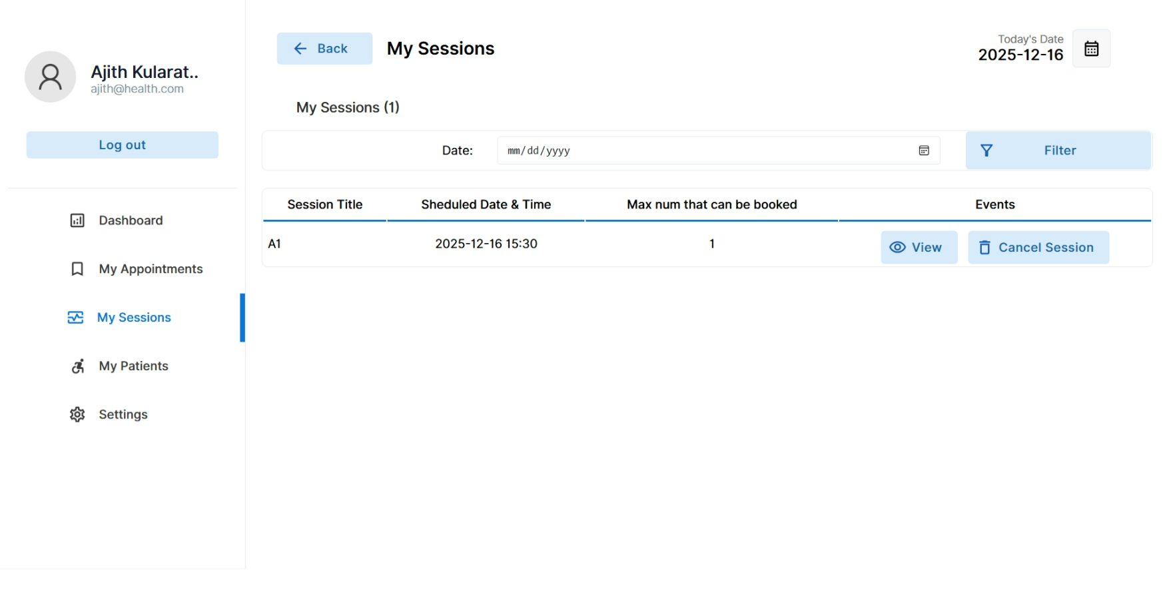
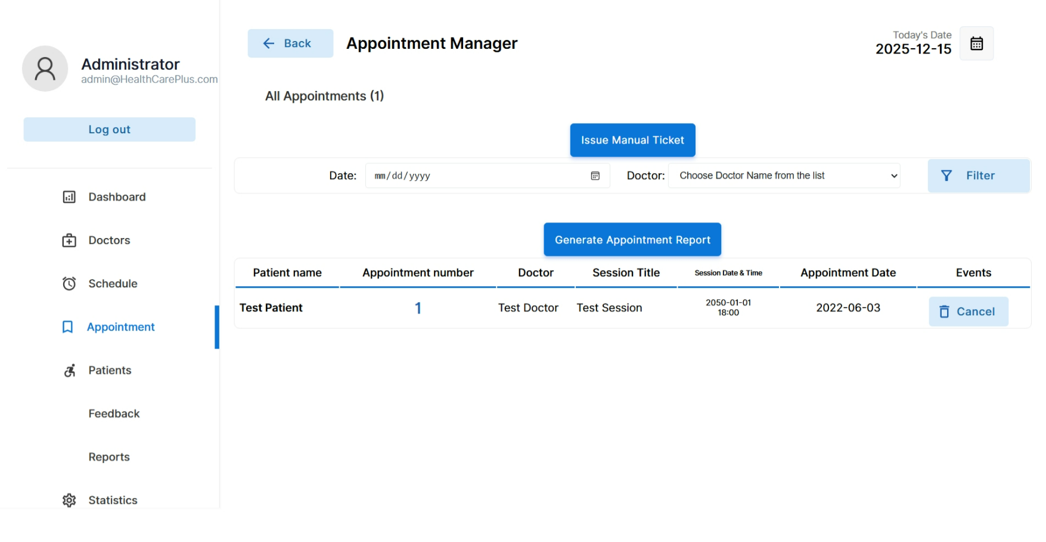
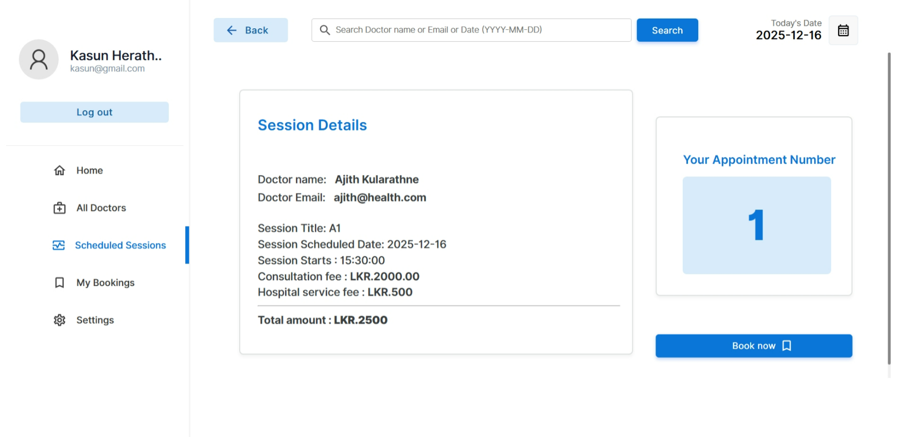
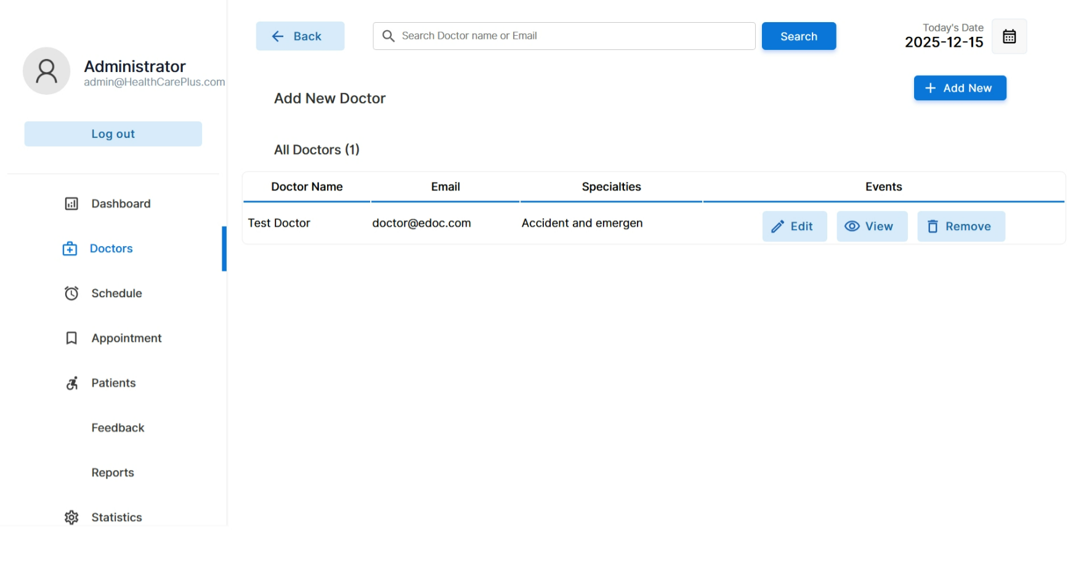
System Architecture.
System Interfaces.

Slide 11
Test Results:
Project Name | Online Hospital Management System for HealthCare Plus Hospital.
Release Version | 1.0
Module Name | User Login
Preconditions | Internet connection available, user account exists.
Test Case ID | Test Case Description | Input | Expected Output | Result
01 | User Login | Empty Username and Password. | Error message “Invalid Credentials”. | Pass
 |  | Incorrect Username and Password. | Error message “We can’t find any account for this email.” | Pass
 |  | Correct Username and Password. | Successfully Message “Login Successfully”. User redirected to role-based dashboard. | Pass
02 | User Registration. | Empty required fields. | Error message “Please fill all required fields.”. | Pass
 |  | Invalid email format. | Error message “Invalid email address.” | Pass
 |  | Password and confirm password mismatch. | Error message “Passwords do not match.” | Pass
03 | Book Appointment | Doctor not selected. | Error message “Please Select a Doctor”. | Pass
 |  | Date not selected. | Error message “Please Select Appointment Date.” | Pass
 |  | Time slot already booked. | Error message “Selected Time Slot Unavailable”. | Pass
04 | Make Payment. | Incorrect Payment Details. | Error message “Invalid Credentials”. | Pass
 |  | Correct details insufficient balance. | Error message “Insufficient Balance.” | Pass
 |  | Correct details and sufficient balance. | Payment Successful and Receipt Generated. | Pass
05 | Make Payment. | Missing mandatory fields. | Error message “Please fill required fields”. | Pass
 |  | Invalid Specialization. | Error message “Invalid Specialization.” | Pass
 |  | All valid details. | Doctor profile added successfully. | Pass

Slide 12

Conclusion:
Future Works.
Mobile Application Development: Presently, the system is an online platform. Future upgrades may involve applications for smartphones running on the Android and iOS operating system. this will give patients the flexibility to use their smartphones to book appointments, send notifications, view medical reports, among functions.
Online Consultation and Telemedicine Support: To cater to this increasing need for telehealth services, certain features of telemedicine can be implemented in this system. the addition of a video conferencing function would enable doctors to conduct virtual sessions, which would benefit patients in distant and emergency circumstances.
Enhanced Appointment Scheduling with AI Assistance: Future updates might bring features like the use of AI for scheduling appointments based on the doctor’s availability, the urgency of the patient’s needs, and past trends. Waiting times and resource allocation in the hospital can thus be optimized.
Interface with Pharmacy and Lab Systems: The system can also be expanded to incorporate other modules, such as managing pharmacies and laboratories. Handling prescriptions and uploading results for lab tests would go a long way in enhancing cooperation and ease within hospital divisions.
Multilingual and Localization Capabilities: Although the current system is able to perform the basic functionality, some future developments that could be introduces into the program include multilingual support, thereby benefiting patients who hail from varying linguistic backgrounds.
Cloud Deployment and Multi-Hospital Capability: Future improvement can then be centered around aspects such as cloud technology, where multiple branches of a hospital can share the same computer system for security purposes.

